Slide 1
Red black trees example

Slide 2
Properties of Red Black Tree
Property #1: Red - Black Tree must be a Binary Search Tree.
Property #2: The ROOT node must be colored BLACK.
Property #3: The children of Red colored node must be colored BLACK. (There should not be two consecutive RED nodes).
Property #4: In all the paths of the tree, there should be same number of BLACK colored nodes.
Property #5: Every new node must be inserted with RED color.
Property #6: Every leaf (i.e NULL node) must be colored BLACK.

Slide 3
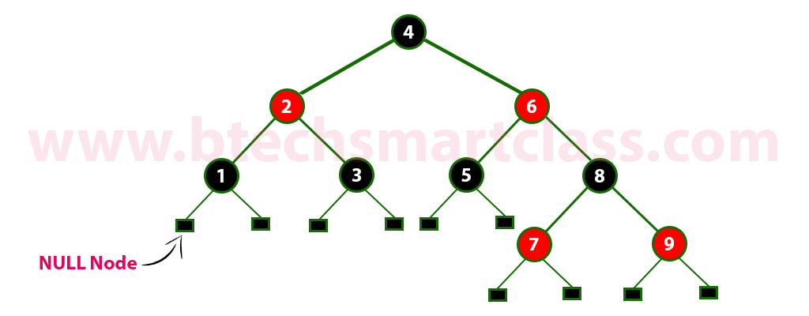
example
Every Red Black Tree is a binary search tree but every Binary Search Tree need not be Red Black tree.

Slide 4
Insertion into RED BLACK Tree
In a Red-Black Tree, every new node must be inserted with the color RED. The insertion operation in Red Black Tree is similar to insertion operation in Binary Search Tree. But it is inserted with a color property. After every insertion operation, we need to check all the properties of Red-Black Tree. If all the properties are satisfied then we go to next operation otherwise we perform the following operation to make it Red Black Tree.
1. Recolor
2. Rotation
3. Rotation followed by Recolor

Slide 5
The insertion operation in Red Black tree is performed using the following steps...
Step 1 - Check whether tree is Empty.
Step 2 - If tree is Empty then insert the newNode as Root node with color Black and exit from the operation.
Step 3 - If tree is not Empty then insert the newNode as leaf node with color Red.
Step 4 - If the parent of newNode is Black then exit from the operation.
Step 5 - If the parent of newNode is Red then check the color of parentnode's sibling of newNode.
Step 6 - If it is colored Black or NULL then make suitable Rotation and Recolor it.
Step 7 - If it is colored Red then perform Recolor. Repeat the same until tree becomes Red Black Tree.

Slide 6
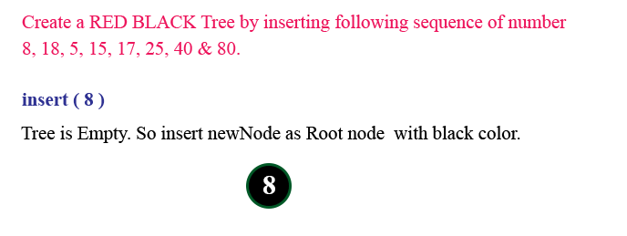

Slide 7
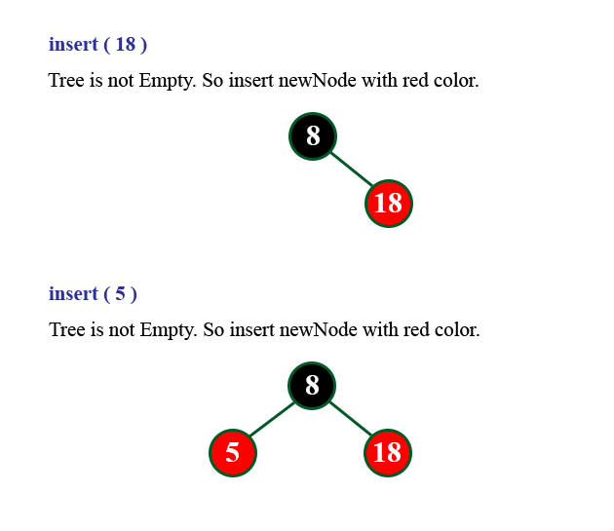

Slide 8
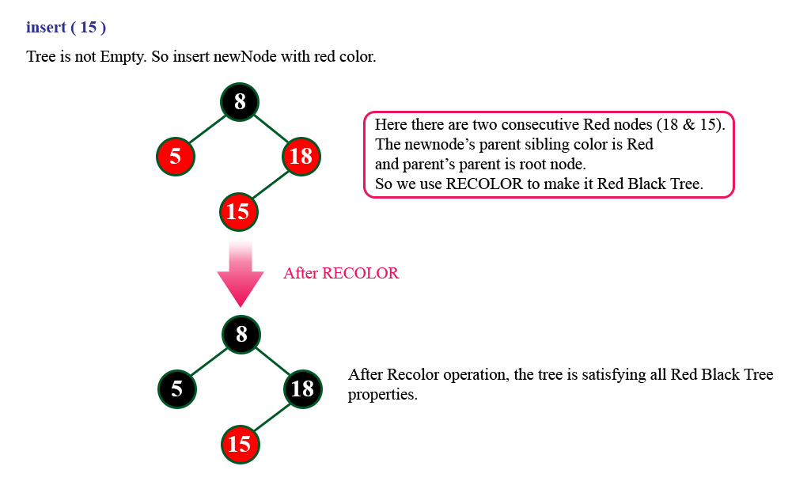

Slide 9
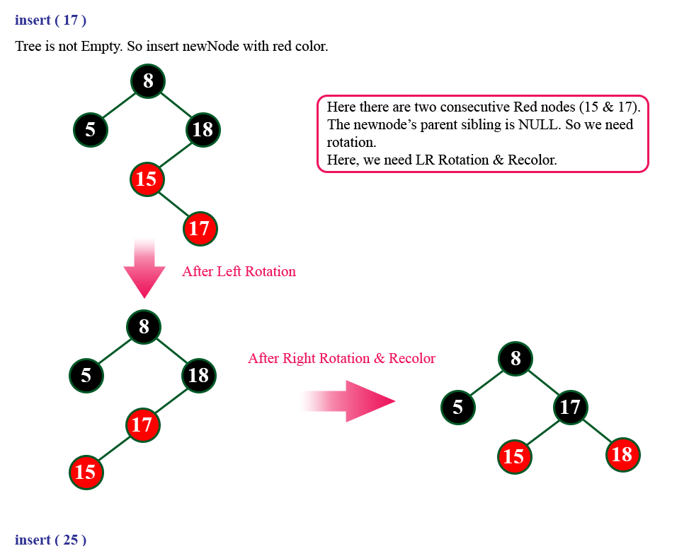

Slide 10
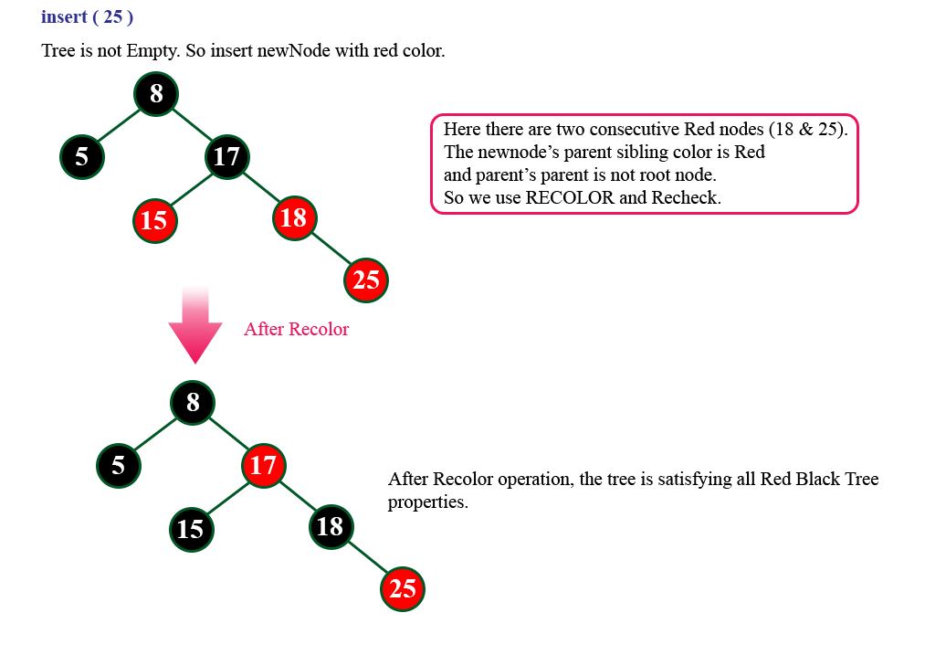

Slide 11
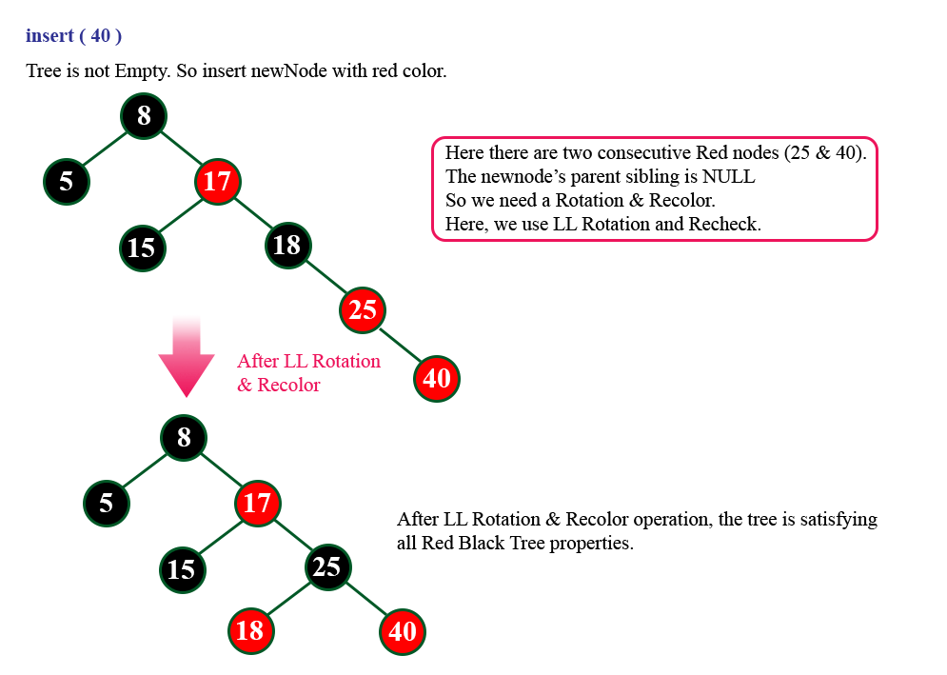

Slide 12
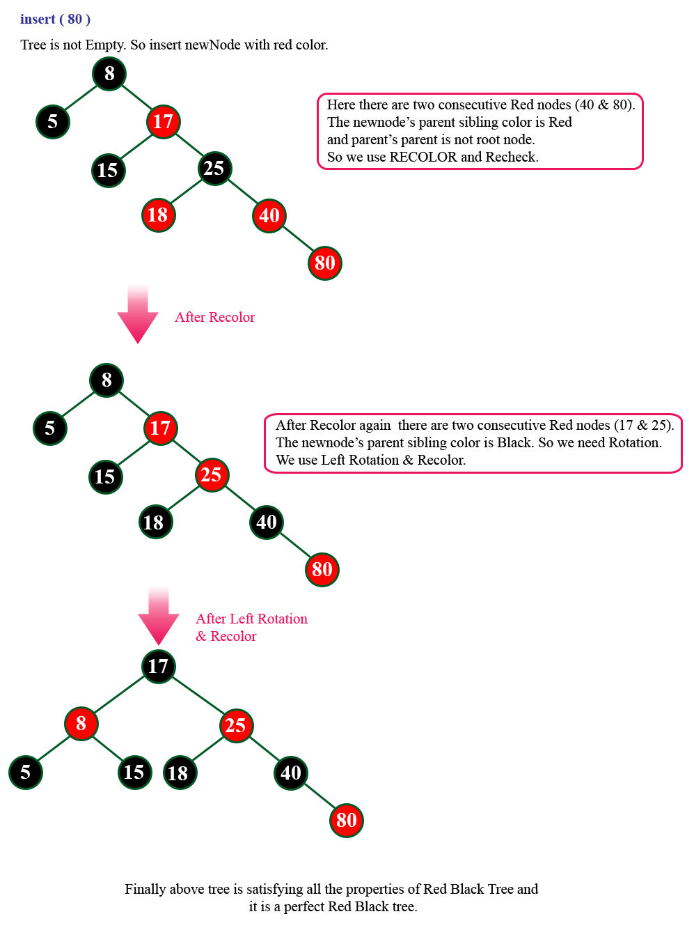

Slide 13
insert into an initially empty red-black tree, the following: 4 7 12 15 3 5 14 18 16 17.
https://www.cs.usfca.edu/~galles/visualization/RedBlack.html

Slide 14
(4B)
(4B (7R))
(4B (7R (12R))) - , need to rotate left ((4R) 7B (12R))
((4R) 7B (12R (15R))) - , need to recolor ((4B) 7B (12B (15R)))
(((3R) 4B) 7B (12B (15R)))
(((3R) 4B (5R)) 7B (12B (15R)))
(((3R) 4B (5R)) 7B (12B ((14R) 15R))) -- , need RL rotation (((3R) 4B (5R)) 7B ((12R) 14B (15R))))
(((3R) 4B (5R)) 7B ((12R) 14B (15R (18R))))) -- , recolor (((3R) 4B (5R)) 7B ((12B) 14R (15B (18R)))))
(((3R) 4B (5R)) 7B ((12B) 14R (15B ((16R) 18R))))) -- , need RL rotation (((3R) 4B (5R)) 7B ((12B) 14R ((15R) 16B (18R))))
(((3R) 4B (5R)) 7B ((12B) 14R ((15R) 16B ((17R) 18R)))) -- , need to recolor (((3R) 4B (5R)) 7B ((12B) 14R ((15B) 16R ((17R) 18B)))) -- , the recolor caused a problem higher up in the tree! -- we need to do a left rotation ((((3R) 4B (5R)) 7R (12B)) 14B ((15B) 16R ((17R) 18B)))

